Slide 1
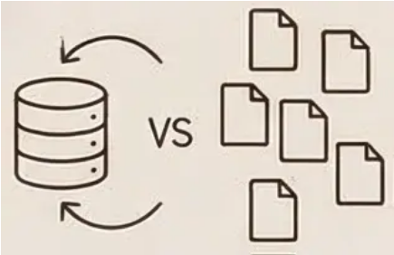
Recap on Databases and File Systems
What is a Database?
Problems with File Systems
An organized collection of structured electronic data controlled by a Database Management System (DBMS).
• Data redundancy and inconsistency (updates required in multiple places). • Difficult access to data. • Data integrity and security issues.
Database Benefits
Real-world Applications
• Eliminates redundancy, ensures consistency. • Simplifies access, maintains integrity, improves security.
• Banking, E-commerce, Healthcare systems requiring reliable data management.

Slide 2

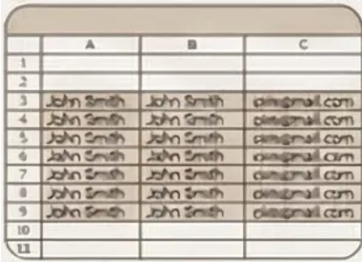
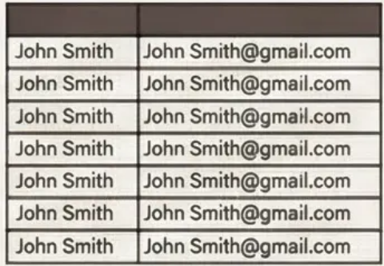
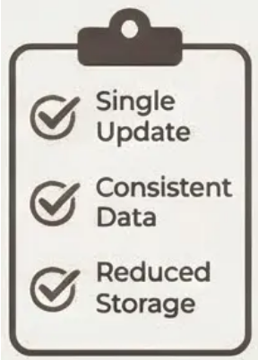
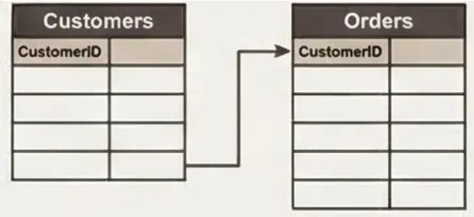
Solving Data Redundancy: Excel vs. Split Tables
01
02
Problem: Data Redundancy
Bad Design Example
When customer information appears in multiple rows, changes must be made everywhere, risking inconsistency.
Single table with John Smith's name and email repeated across multiple order records creates maintenance issues.
03
04
Better Design Solution
Benefits of Split Tables
Separate Customers and Orders tables with CustomerID as the link eliminates repetition of customer details.
Update customer information once, maintain data consistency, and reduce storage requirements.

Slide 3
ERD & Schema
Understanding core database concepts and design process

Slide 4

01
Entity-Relationship Diagrams (ERD)

Slide 5
ERD Components and Symbols
- Entity (table) symbolizes major data objects. person, place, object, event, concept (often corresponds to a real time object that is distinguishable from any other object)
- Attributes (columns) describe entities, property or characteristic of an entity type (often corresponds to a field in a table)
- Relationship lines show connections between entities.(link between entities (corresponds to primary key-foreign key equivalencies in related tables)

Slide 6
ERD ex:
access-date
cust-name
number
cust-id
has
customer
account
cust-street
cust-city
balance

Slide 7

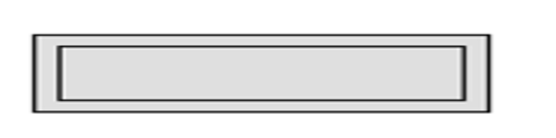
Strong Entity vs Weak Entity
A Strong Entity- An Entity set that has a primary key.
A Weak Entity- An entity set that do not have sufficient attributes to form a primary key.
As: Employee & Dependents in Firms ,Account & Transaction in Banking Systems.

Slide 8
Types of Attributes Simple Attribute->SSN,Age,Gender,....... Composite Attribute ->Name(L_name,F_name), DOB(mm,dd,yy) Multi-valued Attribute -> Phone Number , Address Derived Attribute -> Age (you can calculate it from DOB) Complex Attribute -> Multi-valued + Composite ex:Address

Slide 9
Relationship
Relationship has three Properties:
Degree of Relationships -> Unary,Binary,Ternary
Cardinality Constraint -> 1:1 , 1:M , M:M
Participation Constraint -> Total , Partial

Slide 10
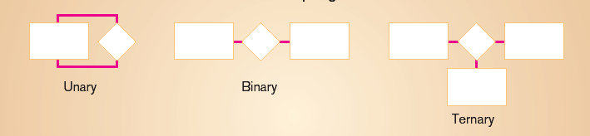
Degree of Participation
Degree: number of entity types that participate in a relationship Three cases
Unary: between two instances of one entity type
Binary: between the instances of two entity types
Ternary: among the instances of three entity types

Slide 11
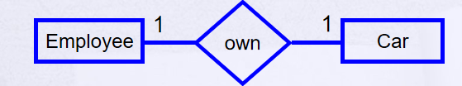
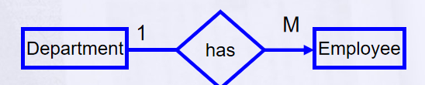
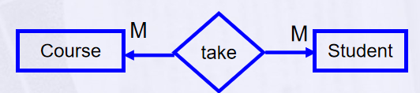
Cardinality
How many instances of one entity will or must be connected to a single instance from the other entities.
One-One Relationship
One-Many Relationship
Many- Many Relationship

Slide 12
Participation
An employee MUST work for a department An employee entity can exist only if it participates in a WORKS_FOR relationship instance So this participation is TOTAL Only some employees manage departments The participation is PARTIAL

Slide 13
Participation
Has
Employee
Car
An Employee may have a car.
A Car must be assigned to particular employee

Slide 14
Hire
Department
Employee
- A department may hire many employees ( Zero or more)
An employee must be employed by a department
(Department membership is Optional, Employee membership is Mandatory)

Slide 15
Keys
Different Types of Keys:
Candidate Key
Primary Key
Foreign Key
Composite Key
Self Study:
Partial Key
Alternate key
Super Key
Notes:
if you make search about them , please share your info about them in general byd chat and wait your gift !

Slide 16
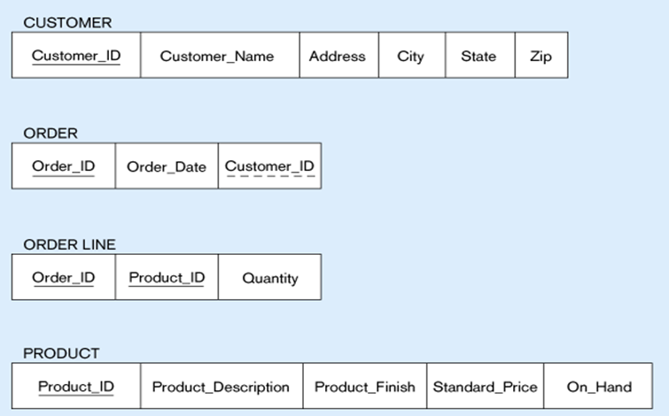
KEYS ex:

Slide 17

Practical Problem

Slide 18
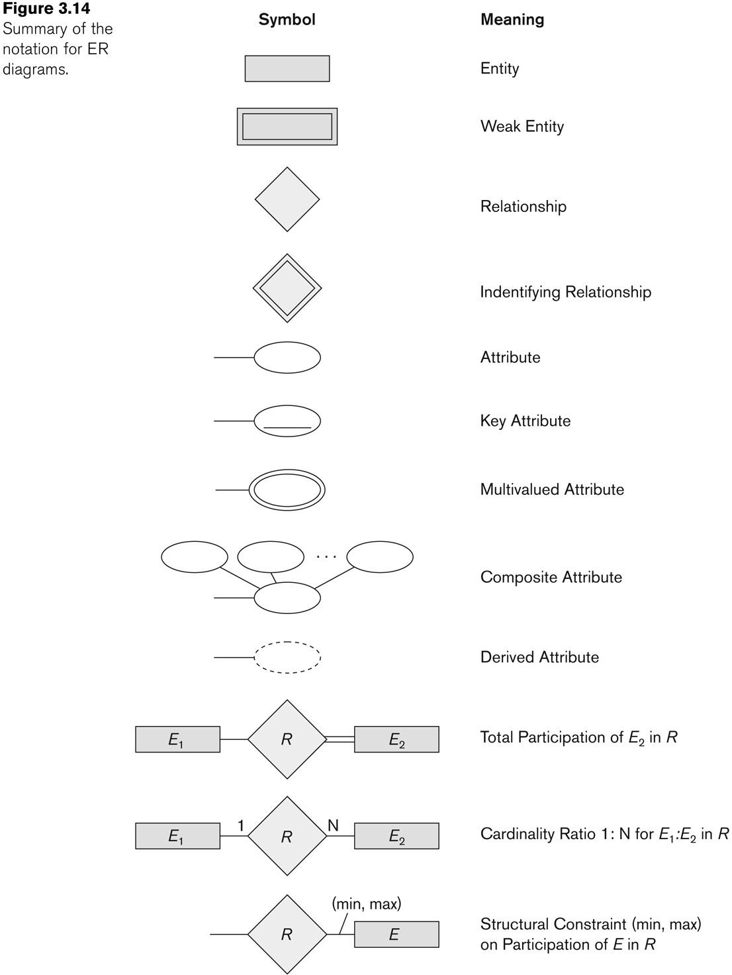

Slide 19
Steps to Design ERD
1. Identify entities , Define attributes for each entity.
2. Choose a Primary Key for unique identification.
3. Define relationships between entities.
4. Define Participation.
5-Define Cardinality.
This structured approach ensures comprehensive and clear ERD creation.

Slide 20

Your Turn to solve !

Slide 21
02
Mapping

Slide 22
Steps to Mapping
Step 1: Mapping of Regular Entity Types
Step 2: Mapping of Weak Entity Types
Step 3: Mapping of Binary 1:1 Relation Types
Step 4: Mapping of Binary 1:N Relationship Types.
Step 5: Mapping of Binary M:N Relationship Types.
Step 6: Mapping of N-ary Relationship Types.

Slide 23
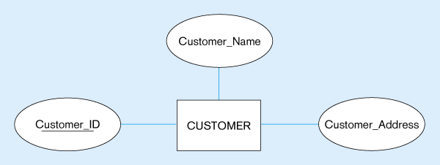
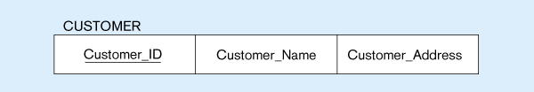
Mapping Regular Entity
(a) CUSTOMER entity type with simple attributes
(b) CUSTOMER relation

Slide 24
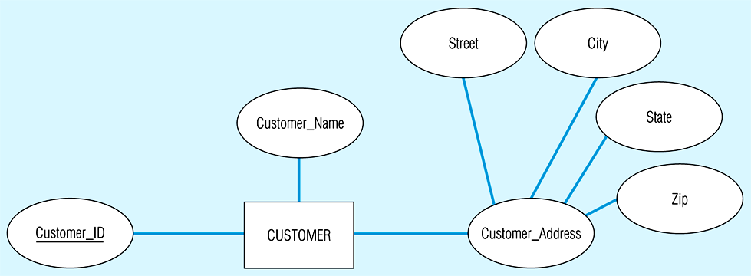
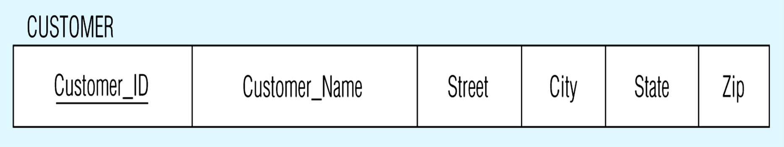
Mapping Composite Attribute
CUSTOMER entity type with composite attribute
CUSTOMER relation with address detail

Slide 25
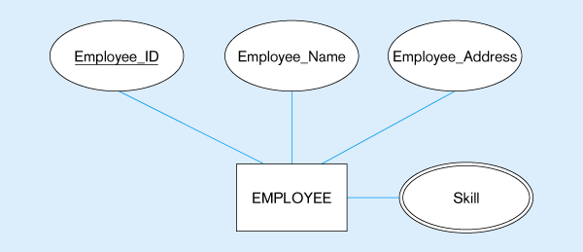
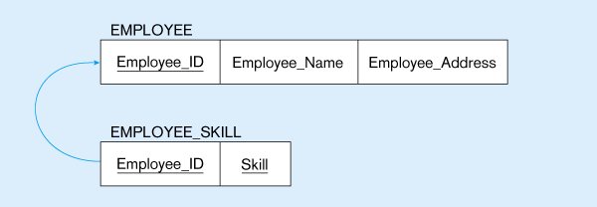
Mapping Multivalued Attribute
Multivalued attribute becomes a separate relation with foreign key

Slide 26
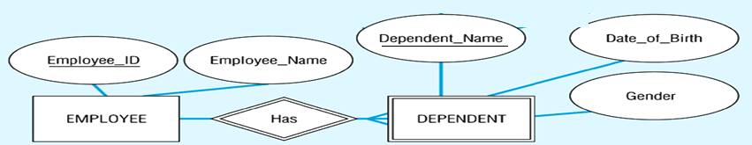
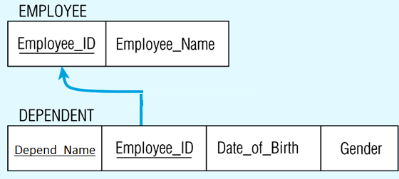
Mapping of Weak Entity
Notes:
Create table for each weak entity.
Add foreign key that correspond to the owner entity type.
Primary key composed of:
Partial identifier of weak entity
Primary key of identifying relation (strong entity)

Slide 27
In the most cases Derived attribute not be stored in DB
Mapping Complex Like Mapping Multivalued attribute then including parts of the multivalued attributes as columns in DB

Slide 28
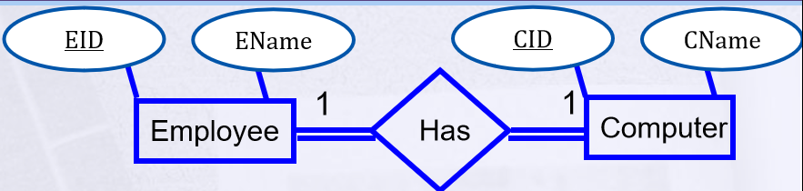
Mapping 1:1 both Total Participation(Mandatory)
Emp(EID, Ename, Cname, CID)

Slide 29
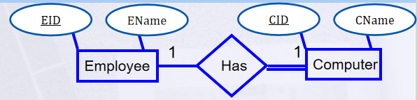
Mapping Partial - Total (optional,mandatory)
Employee(EID, Ename)
Computer(CID, Cname, EID_FK)
partial increase , tables increase

Slide 30
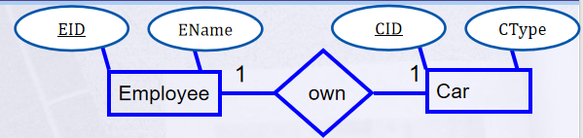
Mapping 1:1 both Participation (optional)
Employee(EID, Ename)
Car(CID, CType)
Emp_Car(EID, CID_FK)

Slide 31
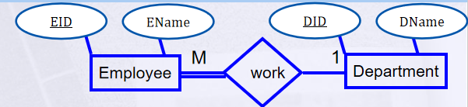
Mapping 1:M Many is Total (Mandatory)
Department(DID, Dname)
Employee(EID, Ename,DID)

Slide 32
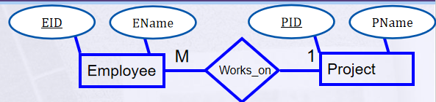
Many is Partial (optional)
Project(PID, Pname)
Employee(EID, Ename)
Proj_Emp(EID,PID_FK)

Slide 33
Mapping M:M Relationship Types
Create a new third table
Add FKs to the new table for both parent tables then third table will have composite PK
Add simple attributes of relationship to the new table if any .

Slide 34
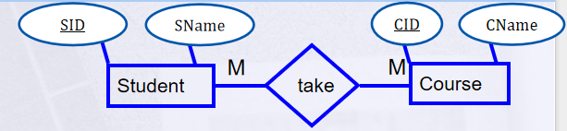
Student(SID, Sname)
Course(CID, Cname)
Stud_Course(SID, CID)

Slide 35
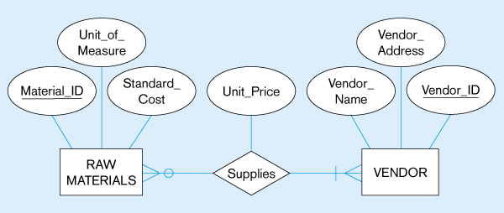
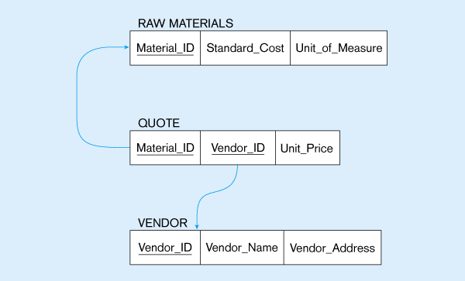
M:M with Attribute

Slide 36
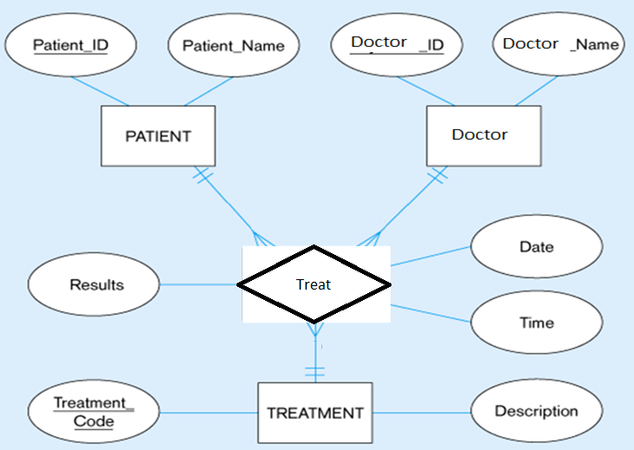
Mapping Ternary Relationship

Slide 37
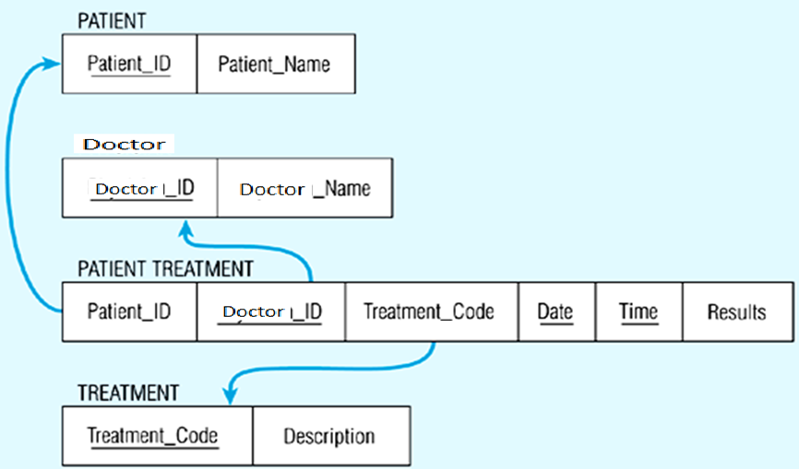

Slide 38
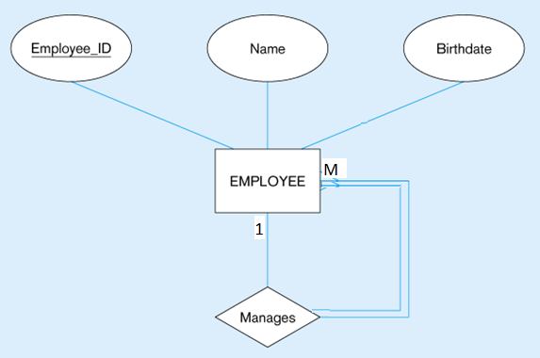

Mapping Unary Relationship

Slide 39
Cases of composite primary key(weak entity,multy valued,complex,M:M), if attribute on realationship put it in table have 2 keys (pk,fk)

Slide 40

Thanks

